Slide 1
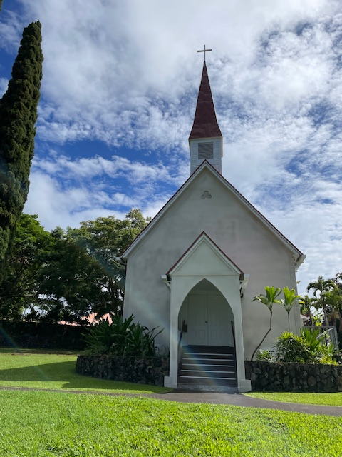
CHRIST CHURCH EPISCOPAL
2025 ANNUAL REPORT
January 25, 2026
Held at QECC and via Zoom

Slide 2
CHRIST CHURCH EPISCOPAL
Annual Meeting
January 25, 2026
Call to Order:
Opening Prayer:

Slide 3
Meeting Agenda
Committee Reports/Other Business
  Altar Guild
  Cemetery
  Christian Education
  Communications and Nu’Oli
  Hospitality
  Nominating
  Outreach (and in Vicar’s report)
  Pastoral Care
  Worship
  Adjourn
Reports
  Vicar
  Bishop’s Warden
  People’s Warden’s
  Treasurer Report
  Old Business
  New Business, Nominations &Voting

Slide 4
Meeting Agenda (cont’d.)
Old Business: Approval of Minutes of Last Annual Meeting – February 5, 2025
New Business:
Nominations to the Bishop to be voted on today
  Nominating Committee Report
      Bishop’s Warden – By Bishop and Vicar – Dennis Costa
      Junior Warden – Via nominating committee – congregation vote today – To nominate to Bishop Bob for this position – Jeanne West for one more year
      Bishop’s Committee – Via nominating committee – congregation vote today (five continuing and one new vacancy)

Slide 5
Meeting Agenda (cont’d.)
            Three-year term vacancy – Julia Lester to replace Allegretto Rhoads, term expires end 2027

Slide 6
Meeting Agenda (cont’d.)
2. Election of Delegates and Alternate(s) to the Annual Diocesan Convention – by Congregation
A. Recommended delegates
i. Dennis Costa and Julia Lester ii. Alternate Sandy Sandin
B. Election: Motion for the church membership to authorize the clerk to cast one written ballot for the slate recommended
by the nominating committee
3. Budget Presentation
Closing Prayer
Adjournment

Slide 7
MINUTES OF ANNUAL MEETING, 2024 p.1
CHRIST CHURCH EPISCOPAL
Annual Meeting
February 2, 2025
In person
CALL TO ORDER: 12:05 pm by Vicar Fr. Dwight Brown
OPENING PRAYER: Vicar Fr. Dwight Brown, Special prayer for a church meeting.
PRESENT: Fr. Dwight Brown, Jasmine Locatelli, Dennis Costa, Barb and Chris Fraley, Martha Morrissey, Karl and Linda Sears, Jeanne West, Reiko and Butch Ford, Sue Roberts, Jane Bockus, Sandra Sandin, Steve, Jen Valdez and Aunt Gail, Al Mackenzie via Zoom, Meg Greenwell, Buzz and Jean Samuelson, Vance and Bethyl Shepperson, Lori Trumbo, Janet Britt, Brenda and George Kikuchi, Kathy Ogata, and Diane and Brian McGurk, Al Rhoads, CJ Kimberly, Carol Greenwell, Fred Dosher, Greg and Pam Maiers, Mike Donegan and Linda Collier.
QUORUM: Established.
A motion was made by Janet Britt, duly seconded by Jen Valdez, and carried by all present to adopt the agenda.
A motion was made by CJ Kimberly, duly seconded by Janet Britt, and carried by all present to appoint Meg Greenwell as clerk for the meeting.

Slide 8
MINUTES OF ANNUAL MEETING, CON’T p.2
REPORTS:
Vicar’s Report: Fr. Dwight Brown, see full report at end of minutes.
  Review of position and responsibilities: 3/8-time salary, ½ time for 9 months.
  Health of Church: very healthy church, parking lot full.
  Growth and Progress.
  Thank you to so many who keep the church functioning with a part-time Vicar and Office Manager.
  Vicar’s Time and services.
  Pastoral Care – Calls, Visits, Home Communion Sacramental.
  Looking forward.
  Major renovation, new lighting, etc. – Dedication in June with Bishop’s visit?
  Baptisms: Daisy Jean Sperka, Tamara Roberson, Euna Elizabeth Boggs
  Burials: Fouad Halaby, Charlie Tyler, Mary Luczon, Tata Gurrobat, David Akana, Linda Melson.
  Thank you to the following and others: Cathy Brown, Dennis Costa, Jeanne West, Steve Valdez, Jackie Baldwin, Meg, Kate Winter, Jasmine Locatelli, Martha Morrissey, Sandy Sandin, Karl Sears, Kela Luczon, Mona Gurrobat, Janet Britt, Cyndi Parks, Julia Lester, Kathy Ogata, Chris and Barb Fraley for Zoom and Malihini Aloha, LEMs and Lectors: Al Mackenzie coordinator, Mona, Jasmine, Al, Betty O’Brien, CJ, Eleanor, Sue and Dick Roberts, Linda Sears and Lori Trumbo, Patty and Bob Trent, Jeanne West-Stewardship, Green Team-Karls Sears, Rick Stambaugh, Linda Sears, Church renovations Jeanne West, Nathan Smith, Buzz Samuelson, Counters Barb and Linda and Jen and Meg.

Slide 9
MINUTES OF ANNUAL MEETING, CON’T. p.3
Bishop’s Warden’s Report: Dennis Costa, see full written report.
  Discussed the position of the Bishop’s Warden. Not elected but recommended to and appointed by the Bishop.
  Helps with Pastoral Care.
  Purchased new hymnals, “Wonder Love and Praise”.
Junior Warden’s Report: Jeanne West
  Buildings:
    Historic Church:
      Renovation Project Completed, Mauka Wall, Makai Wall, and Tower (Steeple). In addition, exterior painting and roof power washing was completed.
      New carpet installed inside and on the exterior steps.
    Queen Emma Community Center:
      New stove installed; new shelving in kitchen.
      New screen door installed.
      Fire alarm covers installed.
      Grease Trap replaced.
      New office computer purchased and installed.
      New web address and email (Office@Christchurchkona.org).
      Volunteers trained for admin support.
    Wallace Hall:
      LED lighting installed throughout (cost of $600 after Hawaii Energy Rebate)
      Lease renewed with Punana Leo.
      Rectory:
        New lease signed with tenants. They are helping to keep the surrounding grounds.
      Blue House:
        Big tree overhanging roof was cut back.

Slide 10
MINUTES OF ANNUAL MEETING, CON’T, p.4
    Wallace Hall:
      LED lighting installed throughout (cost of $600 after Hawaii Energy Rebate)
      Lease renewed with Punana Leo.
      Rectory:
        New lease signed with tenants. They are helping to keep the surrounding grounds.
      Blue House:
        Big tree overhanging roof was cut back.
  Grounds and other:
    Damaged light pole replaced
    Parking lot extension is being kept mowed.
    Coffee Farm lease entered into with Gregorio Meneses.
    Car purchased from departing parishioner for use by visiting clergy and parishioners as needed on a short-term basis.
  Projects for 2025:
    Assessment and recommendations for painting behind altar.
    Railing repair/refinishing
    Installation of new zoom camera; cable covers for speakers and camera.
    Window and windowsill repair.
    Bathroom renovation at Wallace Hall.

Slide 11
MINUTES OF ANNUAL MEETING, CON’T p.5
    Green Team to explore a solar panel project.
COMMITTEE REPORTS:
Altar Guild: Chairs Janet Britt and Meg Greenwell: see attached
  Members: Meg Greenwell, Janet and Tim Britt, Linda Sears, and Jen Valdez.
  Our committee is diligent in setting up both services each week, as well as preparing the church for special services, including weddings, funerals, concerts, and Baptisms. We also prepare the church and the altar for the various celebrations in the church calendar – Christmas, Palm Sunday, and Easter. We also clean all the brass vases, crosses, candelabra, etc. so all is shiny for special days.
  The Altar Guild was ecstatic when it was decided NOT to hold services in the QECC. Moving all the items we need for communion was difficult. Thank you, Bishop’s Committee!!!
  There is one other important need for the Altar Guild and that is for people to sign up for flowers. There is a sign-up sheet in QECC. If you bring flowers to Janet on Friday, she will put them out. MAHALO!!!
Cemetery: Mona Gurrobat, see written report attached.
  Thanks to the gang of volunteers who came to help with the 2024 March workday; we cleared a lot of brush and debris. Didn’t have a big December clean up last year; will try to make better announcements of these events. Going forward in 2025, the spring workday will be April 9 (Wednesday before Palm Sunday) and the workday to clean before Christmas will be Wednesday, Dec. 3. I will do better at advance notice via the Nu’Oli so we can spruce up the cemetery before Easter lilies and poinsettias arrive.
  The burials we had were Charles Tyler in February, Bill and Linda Melson in June, and Mark Gamble in August. In March, Tommy and Ben Greenwell worked hard at repairing a collapsed grave. It took several hours to clean up, repack, and fill and re-cover – a situation that doesn’t regularly or normally occur. And they didn’t charge the church for this service so please share our gratitude whenever you see either of them.
  Down the line… I would like to discuss the project of digitizing the cemetery map for the church website, so those searching for family members’ graves would have a source for the actual location.
      Mahalo, Mona (Ewing) Gurrobat

Slide 12
MINUTES OF ANNUAL MEETING, CON’T, p.6
Christian Education: Vance and Bethyl Joy Shepperson
  Christ Church Home Groups-2024 & 2025
  Home Group #1 (April-June, every other Monday)
    The First Christ Church Home group commenced in April 2024. We read and discussed: Imagine the God of Heaven: Near-Death Experiences, God’s Revelation, and the Love You’ve Always Wanted. We followed Questions from the book as a format to learn and discuss as well as to grow as a body of believers in friendship.
    We celebrated Anniversaries and birthdays of members, stayed connected during breaks with texting.
    Folks felt free to come, try the group out. Some remained, others had other callings. We met in several members’ homes through the months.
  Home Group #2
    We changed the format to every Monday, for 6 weeks.
    The topic was: “How to Pray: A Simple Guide for Normal People” by Pete Greig. The video and discussion questions became a good way to learn, share, and connect.
  Home Group #3
    Continues now, Feb.3-March 3, 2025, 5 weeks.
    Video and Discussion of Pete Greig’s “Unanswered Prayer” series.

Slide 13
MINUTES OF ANNUAL MEETING, CON’T, p.7
Communications Committee: Kate Winter:
  The committee members have been generous in time and talents for the website, fund-raising and Nu ‘Oli by generously using the various skills of the members – Janet Britt, Chris Fraley, Jeanne West.
  Janet is faithfully producing the Nu ‘Oli weekly. The parish birthday list continues to be updated and is included in the weekly Nu ‘Oli. Birthday cards are sent to all on the list. Please let Janet know if you would like to add your special day to the list, office@christchurchkona.org.
  Mahalo to Chris for also providing Zoom access to our worship services in the historic church as well as the Queen Emma Center.
  Jeanne took on the pledge drive with writing and editing as well as the stewardship mailing. Having Jeanne as People’s Warden and Communication Committee member is a double blessing. She has taken on many of our tech challenges, gathering information and communicating it to those of us who try to keep up.
  We have created new signage that is welcoming and informative to increase security and parking compliance around the campus including the fences below the graveyard.
  We are happy to have people join us. Anyone who wants to share the varied communication tasks for the parish is welcome.
      Respectfully submitted, Kate Winter

Slide 14
MINUTES OF ANNUAL MEETING, CON’T, p.8
Hospitality: see attached.
  Malihini Aloha
    This social event takes place on the third Wednesday of (almost) each month and begins at 5:30pm. The host is responsible for supplying the space and tableware, and perhaps some ice and a pitcher of water – it’s the easiest party you will ever host!
    Malihini aloha has morphed a bit from a pupu party to more of a potluck dinner. Gatherings in 2024 were generally well-attended and enjoyed by all.
    Barb Fraley oversees recruiting hosts and scheduling. Hosts are still needed for several months later in 2025.
Pastoral Care:
  Pastoral Care consists largely of visits, particularly to those in the hospital, care facilities, or who are housebound. These visits include prayer, counsel, and often Holy Communion.
  Pastoral care also included conversations with those in need, financial aid through the Benevolence Fund, counselling, and service: Baptisms, Funerals, Weddings, etc.
  This is generally provided by the Vicar, or supply clergy in the Vicar’s absence. We also are serviced by Dennis Costa who offers much moral support and counsel; also, by LEMs who are trained to make home visits and deliver Holy Communion. We are also blessed to have a retired Priest, The Rev. Brian McGurk in the congregation and willing to assist with pastoral care.

Slide 15
MINUTES OF ANNUAL MEETING, CON’T, p.9
Worship Committee:
  The Worship Committee meets as needed, to plan services and events, particularly around major feasts and fasts in the church year. Active are The Vicar, Dennis Costa, Jeanne West, Janet Britt, Kathy Ogata and Martha Morrissey.
  This committee was helpful in planning Holy Week and Easter, to include a Seder and Foot Washing on Maundy Thursday, Stations of the Cross on Good Friday, and an Easter Vigil, Saturday evening at 5:00pm as well as on Easter Sunday. It also made decisions regarding the Christmas schedule and service.
  The meetings included discussion of the use of the Historic Church and the QECC for Worship. The Committee felt that it was important to use both buildings and to work out a monthly schedule to that effect. The Historic Church offers an atmosphere of Holiness and Tradition; the QECC offers more light, space and an atmosphere for a more creative service. The Bishop’s Committee opted for the consistent use of the Historic Church; this was in order to use and enjoy the new organ and also because of the added work involved in setting up the QECC as a worship space.

Slide 16
MINUTES OF ANNUAL MEETING, CON’T, p.10
Nominating Report: Karl Sears; members Dennis Costa and Jeanne West
  Current Bishop Committee (BC) Members (2024)
    Bishop: Robert Fitzpatrick
    Vicar: Dwight Brown
    Bishop’s Warden: Dennis Costa (2023-2024)*
    People’s Warden: Jeanne West (2-23-2024)*
    Clerk/Secretary: Meg Greenwell
    Lay Members (terms):
      Martha Morrissey (2024-2026)
      Vance Shepperson (2022-2024)*
      Sandy Sandin (2023-2025)
      Steve Valdez (2023-2025) – also current Treasurer
      Jasmine Locatelli (2024-2026)
      Karl Sears (2024-2026)
      * term expired

Slide 17
MINUTES OF ANNUAL MEETING, CON’T, p.11
  Tasks for 2025 Annual Meeting:
    Dennis Costa’s new term as Bishop’s Warden to be approved by the Bishop (recommended to Bishop by Vicar Dwight Brown).
    Approve Nomination of Jeanne West to the Bishop as People’s Warden for another one-year term.
    Approve by-law changes, already approved by the BC, to permit the Bishop’s and People’s Wardens to serve up to 4 years consecutively.
      A motion was made by Sue Roberts, duly seconded by CJ Kimberly, and carried by all present to approve Jeanne West to another one-year term as People’s Warden.
      A motion was made by Sue Roberts, duly seconded by CJ Kimberly, and carried by all present to approve the change to the by-laws by approving Wardens serve up to 4 years.
    Approve the nomination of Allegretto Rhoads for a 3-year term to replace Vance Shepperson.
      A motion was made by Janet Britt, duly seconded by Kathy Ogata, and carried by all to approve Al Rhoads for a 3-year term on the BC.

Slide 18
MINUTES OF ANNUAL MEETING, CON’T, p. 12
    We need one volunteer from the congregation to serve as delegate to the Diocesan Convention in October (October 24 & 25). We are allotted 3 delegates, and we presently have 2 (Jeanne and Jasmine). The alternate delegate is Karl Sears.
      Delegates elected are Jasmine, Julia, and Dennis.
      Alternates elected are Karl, Diane, and Jeanne.
Tasks for Bishop’s Committee:
      The existing BC will meet briefly at the end of the annual meeting to approve Steve Valdez as treasurer and Meg Greenwell as clerk for 2025.
  "The above objectives were accomplished".
Outreach Report:
  Christ Church reaches out to its members and to the larger community in many ways.
  Janet would like to allow Konawaena students to use the benches and the area in front of the church before and after school. Also, she would like to allow parents to park in the parking lot to wait for their children. This is an important community outreach.
    Punana Leo
    Vicar’s discretionary fund; “Little Red Church” Food Security
    Marshallese Community
    Community Service and Volunteer Work
    Queen Emma Community Center is used by community groups, such as Vendors, Keauhou Yacht Club, concerts, etc.

Slide 19
MINUTES OF ANNUAL MEETING, CON’T, p.13
OLD BUSINESS:
Approval of Minutes of last Annual Meeting held February 4, 2024.
  A motion was made by Steve Valdez, duly seconded by Sue Roberts, and carried by all present to waive the reading of the meeting minutes and adopt them.
NEW BUSINESS:
BUDGET PRESENTATION AND DISCUSSION: see attached.
OTHER BUSINESS:
ADJOURNMENT: 1:30 p.m.
NEXT ANNUAL MEETING: Sunday, January 26, 2026
CLOSING PRAYER: Fr. Dwight led us in the Lord’s Prayer.
Respectfully submitted,
M. E. Greenwell, Clerk

Slide 20
Vicar’s Report
Rev. Canon Dwight L. Brown, Vicar
c Vicar's Time and Care
Pastoral Care Fund
Parishioner Involvement in Community
Queen Emma Community Center
Pastoral Care Fund.
Konawaena School; 12 Thanksgiving dinners
For Pastoral Care Fund:
2025 Disbursements: $16,500
Individuals in Crisis: 7,700
Food Security (people and agencies): 6,700
Cultural (KCS, Band, etc.) 600
Churches 500
International (Haiti, South Sudan) 1000

Slide 21
Bishop’s and People’s Warden Report
BISHOP’S WARDEN REPORT
1. Becoming a Bishop's Warden. What is a Bishop's Warden?
2. Duties of the Warden.
3. Thanks to all who help in the church services, including the altar guild,
readers and Eucharistic Ministers.
4. Also, I would like Jasmine Locatelli to come forward and explain her role in finding priests to celebrate the Holy Eucharist in Fr. Dwight's absence.
5. Concluding recommended the movie The Bishop's Wife’
Also, a letter written by our Bishop Bob.
6. Do any of you have any questions?

Slide 22
People’s Warden Report, 2025
The historic church renovation was completed in 2024, and in the summer of 2025, we held a celebration/blessing of the work at a time when Nathan Smith and Mark Hummel and Vicar Dwight could participate and lead.
A big project for 2025 was the installation of solar panels. The inspiration, creative energy, and fundraising leadership behind this project was Karl Sears as head of the Green Team, and I’ll defer to his reporting on this project. My role was to write grant proposals to the Atherton Foundation (which contributed $17,000) and the Diocese (which contributed $800). I also oversaw installation of security fencing around the electrical works on the north side of the QECC. The fellow who installed the security fencing also installed a gate across the trash bin area, significantly reducing the damage done by pigs.

Slide 23
PEOPLE’S WARDEN REPORT, Pg. 2
Another project was to follow through on the Bishop’s Committee’s decision to demolish the Blue House, which had been rented for almost 30 years by the same family. Nevertheless, the house was unsafe to live in and estimates we secured for its repair made renovation financially impossible for the church. We gave the tenants 9 months to vacate. We applied to the Diocese (the legal owner of the property) and received permission to demolish the house. Working, again, with Hummel Construction, we have applied for all the necessary county permits for demolition and are awaiting final approval.
We had problems again at the start of the school year with mischief done primarily by high school students hanging around the QECC after school (and sometimes during the day as truants). I re-distributed our letter to anyone picking up students that they had to do pick-ups elsewhere, and adults were agreeable and understanding. We also bought a lock for the entry gate. It can’t be locked while the pre-school is in session but is locked overnight and on the weekends. Student traffic has been significantly reduced.

Slide 24
PEOPLE’S WARDEN REPORT, pg.3
Leases were renewed for Punano Leo, the rectory (with a 5% rent increase), and the coffee “farm.”
General Repairs (all the credit goes to Buzz Samuelson)
  The window frame and windowsill in the chapel replaced and re-painted
  The railings in the chapel refinished
  Shelving built and installed in the two QECC storage closets
  Men’s toilet repaired (by plumber), but Buzz replaced the fallen ceiling tiles.
  Gate hinges replaced and repaired
  Gutters cleaned
Projects for 2026
  Complete demolition of Blue House
  Repair/replace signage at the Highway
  Keep working on the art restoration guy to get him over here to help us decide what to do about the painting behind the altar
  Apply for an interest-free loan from the Diocese to help with solar panel costs
  Write/submit final report to Atherton Foundation for Solar panel grant

Slide 25
2025 Budget vs. Actuals January-December, 2025 p.1
Distribution account 2025
Over Budget Percent of
Actual Budget by Budget
Income
4000 Property Rental 70,817 69,000 1,817 103%
4100 Pledge Payments 129,452 120,000 9,452 108%
4150 Pledge Payments (Prior Yr) 12,870 12,870
4160 Pledge Payment (Next Yr) 1,225 1,225
4200 Plate Offerings 33,394 11,000 22,394 304%
4300 Other Operating Income/Gifts 6,791 33,000 -26,209 21%
4400 Investment Income 6,746 6,000 746 112%
4500 MISCELLANEOUS INCOME 200 200
4650 Interest Income 54 54
Total for Income 261,549 239,000 22,549 109%

Slide 26
2025 Budget vs. Actuals, p.2 January-December 2025
Distribution account 2025
Over Budget Percent of
Actual Budget by Budget
Cost of Goods Sold
Gross Profit 261,549 239,000 22,549 109%
Expenses
60165 Personnel Expenses
60170 Salary & Wages 76,861 77,300 -439 99%
60175 Employee Reimb. Exp. 4,740 4,740
60180 Payroll Taxes 2,956 3,600 -644 82%
60190 Payroll Service Fee 3,543 3,600 -57 98%
Total for 60165 Personnel Expenses 88,101 84,500 3,601 104%
60300 Administration Expenses
60000 Diocesan Assessment 32,035 35,000 -2,965 92%
60100 Insurance 23,948 20,000 3,948 120%
60360 Office Supplies & Other 5,392 4,000 1,392 135%
60375 PayPal Fees 182 182
60380 Software, Subscriptions, Website 5,854 3,000 2,854 195%
60750 Vehicle Repairs & Maintenance 1,551 1,000 551 155%
61000 Property Taxes 573 600 - 27 96%
61100 Other Expenses 2,712 5,500 -2,788 49%
Total for 60300 Administration Expenses 72,246 69,100 3,146 105%

Slide 27
2025 Budget vs. Actuals, January-December 2025 p. 3
Distribution account 2025
Over Budget Percent of
Actual Budget by Budget
60400 MUSIC & WORSHIP
60240 Supply Clergy 4,530 6,000 -1,470 76%
60455 Music Supplies & Other 841 3,000 -2,159 28%
60470 Worship Supplies & Other 679 500 179 136%
Total for 60400 MUSIC & WORSHIP 6,050 9,500 -3,450 64%
60495 Facilities & Grounds Expenses
60500 Property Repairs & Mntce 5,792 6,000 -208 97%
60540 Janitorial Services 10,489 6,000 4,489 175%
60600 Utilities 5,660 9,600 -3,940 59%
60700 Landscaping Services 34,486 33,000 1,486 105%
Total for 60495 Facilities and
Grounds Expenses 56,427 54,000 1,827 103%

Slide 28
2025 Budget vs. Actuals, January – December 2025, p.4
Distribution account 2025
Over Budget Percent of
Actual Budget by Budget
60800 Rental Expense
60820 State Excise Tax (R) 3,300 3,000 300 110%
60825 Property Repairs & Mntc (R) 1,785 1,785
60840 Utilities (R) 12,341 15,000 -2,659 82%
60860 Insurance (R) 19,281 25,000 -5,719 77%
60880 Other Rental Expenses (R) 939 939
Total for 60800 Rental Expense 37,646 43,000 -5,354 88%
Uncategorized Expense 149 149
Total for Expenses 260,620 260,700 -80 100%
Net Operating Income 929 -21,700 22,629 -4%
Other Income
Other Expenses
Net Other Income
Net Income 929 -21,700 22,629 -4%
Cash Basis Monday, January 19, 2026 06:04 AM GMT

Slide 29
Budget Overview_2026 Annual
Christ Church Episcopal, January-December, 2026
ACCOUNT NAME 2026
Income
4000 Property Rental 47,000.00
4100 Pledge Payments 112,000.00
4150 Pledge Payments (Prior Yr) 0.00
4160 Pledge Payment (Next Yr) 0.00
4200 Plate Offerings 30,000.00
4300 Other Operating Income/Gifts 6,500.00
4400 Investment Income 7,000.00
Total for Income 202,500.00
Cost of Goods Sold
Gross Profit 202,500.00
Expenses
60165 Personnel Expenses
60170 Salary & Wages 83,500.00
60180 Payroll Taxes 5,300.00
60190 Payroll Service Fee 4,000.00
Total for 60165 Personnel Expenses 92,800.00

Slide 30
Budget Overview_2026 Annual
Christ Church Episcopal, January-December, 2026, p.2
ACCOUNT NAME 2026
60300 Administration Expenses
60000 Diocesan Assessment 28,000.00
60100 Insurance 24,000.00
60360 Office Supplies & Other 5,400.00
60375 PayPal Fees 200.00
60380 Software, Subscriptions, Website 6,000.00
60750 Vehicle Repairs & Maintenance 1,500.00
61000 Property Taxes 600.00
61100 Other Expenses 2,800.00
Total for 60300 Administration Expenses 68,500.00
60400 MUSIC & WORSHIP
60240 Supply Clergy 5,000.00
60455 Music Supplies & Other 900.00
60470 Worship Supplies & Other 700.00
Total for 60400 MUSIC & WORSHIP 6,600.00
60495 Facilities & Grounds Expenses
60500 Property Repairs & Maintenance 6,700.00
60540 Janitorial Services 11,000.00
60600 Utilities 6,000.00
60700 Landscaping Services 35,000.00
Total for 60495 Facilities & Grounds Expenses 58,700.00

Slide 31
Budget Overview_2026 Annual
Christ Church Episcopal, January-December, 2026, p.3
Account Name 2026
60800 Rental Expense
60820 State Excise Tax (R) 3,000.00
60825 Property Repairs & Maintenance (R) 2,500.00
60840 Utilities (R) 12,000.00
60860 Insurance (R) 20,000.00
60880 Other Rental Expenses (R) 1,000.00
Total for 60800 Rental Expense 38,500.00
Total for Expenses 265,100.00
Net Operating Income 62,600.00

Slide 32
Nominating Report, January 2026 p. 1
Chair: Karl Sears
Members: Dennis Costa and Jeane West
Current Bishop Committee (BC) Members (2025)
Bishop: Robert Fitzpatrick
Vicar: Dwight Brown
Bishop’s Warden: Dennis Costa (2024-2025)*
People’s Warden: Jeanne West (2024-2025)*
Clerk/Secretary: Meg Greenwell
Lay Members (terms)
Martha Morrissey (2024-2026)
Al Rhodes (2025-2027)**
Sandy Sandin (2023-2025)*
Steve Valdez (2023-2025)*--also current treasurer
Jasmine Locatelli (2024-2026)
Karl Sears (2024-2026)
*term expired
** resigning

Slide 33

Tasks for 2026 Annual Meeting
Dennis Costa’s final one-year term as Bishop’s Warden to be approved by Bishop (recommended to Bishop by Vicar).
Approve nomination of Jeanne West as People’s Warden for a final one-year term.
Approve Julia Lester to replace Al Rhodes & to complete his 3 year term which expires at the end of 2027.
Approve Sandy Sandin & Steve Valdez to final 3 year terms which will expire at the end of 2028.
Approve our present 2 allotted delegates to the 2026 Diocesan Convention, Dennis Costa and Julia Lester, and our alternate delegate, Sandy Sandin.

Slide 34
Nominating Report, pg 3
Tasks for Bishop’s Committee
The existing BC will meet briefly after the annual meeting to approve Steve Valdez as Treasurer and Meg Greenwell as Clerk for 2026.

Slide 35
Altar Guild Report
Chairs: Meg Greenwell, Janet Britt, Linda Sears
  Members: Meg Greenwell, Linda Sears and Janet and Tim Britt, Jen Valdez
  Our Committee is diligent in setting up for both services each week, as well as preparing the church for special services, including weddings, funerals, concerts, and baptisms. We also prepare the church and the altar for the various celebrations in the church calendar – Christmas, Palm Sunday, and Easter. We also clean all the brass vases, cross, candelabra, etc. so all is shiny for special days.
  There is one other important need for the Altar and that is for people to sign up for flowers. There is a sign-up sheet in QECC. If you bring flowers to Janet on Friday, she will put them out. MAHALO!

Slide 36
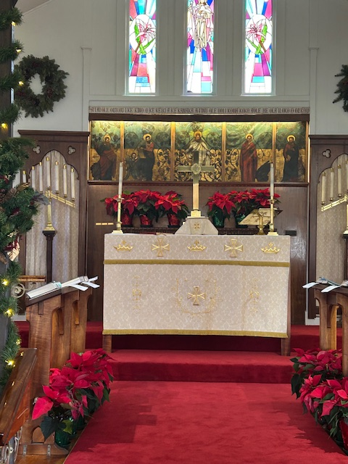
The Poinsettias on the Altar and all along the choir pews made the church extra-beautiful during the Christmas Season.
We got new carpet and the church renovations were completed. It looks fabulous!

Slide 37
Cemetery Report
Not much happened in the cemetery last year….the only change was that Tommy and Ben Greenwell brought some pallets and fastened them together to serve as a small composting bin, for discarded flowers and greenery from gravesites.
The burials we had were
Allen and Helen Kennedy in April
David Krieger in July
Bob Foerster and Beryl Spalding in December
And I just received more cemetery files/information to sort out. Once that is done and the cemetery map is verified, I am still thinking about the project of digitizing the cemetery map for our church website, so those searching for family membersʻ graves would have a source for the actual location.
Mahalo,
Mona Gurrobat

Slide 38
Christ Church Home Group 2025
Facilitators: Vance and Bethyl Shepperson
Focus: Spring and Summer topics this year were:
Pete Greig’s Unanswered Prayer Series.
Lectio Divina Series. with Pete Greig.
These groups were discussion, prayer, and watching video presentations.
Focus: Fall and Winter
Readings and Discussion from Into The Mess and Other Jesus Stories: Reflections on the Life of Christ. Author: Debi Thomas
Since our focus on the parables and teachings of Jesus, there has been an increase in membership, interest and involvement in the home group fellowship. For each person who has participated, we are grateful for your life, perspectives, and the courage to challenge one another in our personal growth.
Also, there’s been a mix from time to time with picnics and dinners. Many joined for Thanksgiving-on-the-lawn.
As we have stretched the parables into our personal lives, one outgrowth was providing 12 meals for families with insufficient needs at Konawaena High School for Thanksgiving.
A follow-up Collaboration Meeting is set for February 3, 2026 with Ami Akeo, Principal and Richelle Tagawa, Human Resources with Vance and Bethyl Shepperson.
Thank you to our group members, Father Dwight Brown, and the Christ Church Bishop’s Committee for your love and support.
Grateful, Vance, Bethyl, and Home Group

Slide 39
Communications Committee 2025

Slide 40
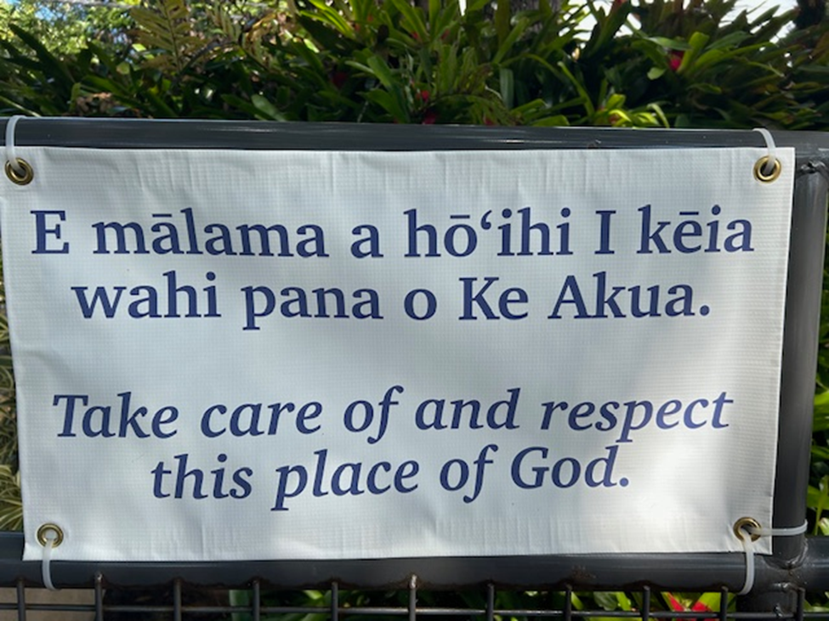
Communications Committee 2025, pg 2
Kate Winter had this welcoming sign made for our front gate.
Mahalo Kate.

Slide 41
Hospitality Report
Christ Church’s Malihini Aloha gatherings continue to be fairly well attended, and very much enjoyed by all who participate.
It is becoming difficult to find hosts for every month. In fact, we had to cancel January and June gatherings in 2025 for lack of host. Many of our parishioners feel that their homes are too small to comfortably accommodate the size of group we often get.
We adjusted the start time of the past several gatherings from 5:30p.m. to 5:00p.m. so that folks may arrive in full daylight. This has worked well, although it has made for a little bit of confusion.
Barb Fraley continues to attempt to schedule hosts and coordinate announcements.

Slide 42
Outreach
Christ Church reaches out to its members and to the larger community in many ways.
Punana Leo
“Little Red Church”
Marshallese Community
Community Service and Volunteer Work
Queen Emma Center used by community groups, such as Vendors, Keauhou Yacht Club, concerts such as Early Music Hawaii
Tutu and Me

Slide 43
Pastoral Care Report

Slide 44
WORSHIP COMMITTEE
The Worship Committee meets as needed, to plan services and events, particularly around major feasts and fasts in the church year. Active in the Worship Committee are: Vicar Brown, Dennis Costa, Jeanne West, Janet Britt, Kathy Ogata, and Martha Morrissey.
The Committee was helpful in planning Holy Week and Easter, to include a seder and Foot Washing on Maundy Thursday, Stations of the Cross on Good Friday, and an Easter Vigil on Saturday before Easter. Decisions were also made about the Christmas schedule and service.

