Slide 1
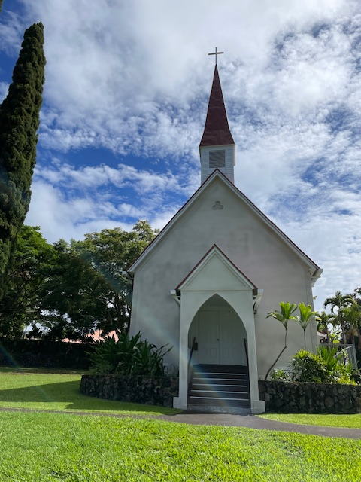
CHRIST CHURCH EPISCOPAL
2024 ANNUAL REPORT
February 2, 2025
Held at QECC and via Zoom

Slide 2
CHRIST CHURCH EPISCOPAL
Annual Meeting
February 2, 2025
Call to Order:
Opening Prayer:

Slide 3
Meeting Agenda
Committee Reports/Other Business
  Altar Guild
  Cemetery
  Christian Education
  Communications and Nu’Oli
  Hospitality
  Nominating
  Outreach (and in Vicar’s report)
  Pastoral Care
  Worship
  Old Business
  New Business, Nominations &Voting
  Adjourn
Reports
  Vicar
  Bishop’s Warden
  People’s Warden’s
  Treasurer Report

Slide 4
Meeting Agenda (cont’d.)
Old Business: Approval of Minutes of Last Annual Meeting – February 4, 2024
New Business:
Nominations to the Bishop to be voted on today
  Nominating Committee Report
      Bishop’s Warden – By Bishop and Vicar – Dennis Costa
      Junior Warden – Via nominating committee – congregation vote today – To nominate to Bishop Bob for this position – Jeanne West for one more year
      Bishop’s Committee – Via nominating committee – congregation vote today (five continuing and one new vacancy)

Slide 5
Meeting Agenda (cont’d.)
            Three-year term vacancy – Allegretto Rhoads to replace Vance Shepperson

Slide 6
Meeting Agenda (cont’d.)
2. Election of Delegates and Alternate(s) to the Annual Diocesan Convention – by Congregation
A. Recommended delegates
i. Jeanne West and Jasmine Locatelli; need one more
delegate
ii. Alternate Karl Sears – need two more
B. Election: Motion for the church membership to authorize the clerk to cast one written ballot for the slate recommended
by the nominating committee
3. Budget Presentation
Closing Prayer
Adjournment

Slide 7
Vicar’s Report
Rev. Canon Dwight L. Brown, Vicar
Health of Church
Growth and Progress.
Thank you to so many who keep the church functioning with a part-time Vicar and Office Manager
Vicar's Time and services
Pastoral Care – Calls, Visits, Home Communion
Sacramental
Looking forward

Slide 8
MINUTES OF ANNUAL MEETING, 2024 p.1

Slide 9
MINUTES OF ANNUAL MEETING, CON’T p.2

Slide 10
MINUTES OF ANNUAL MEETING, CON’T. p.3

Slide 11
MINUTES OF ANNUAL MEETING, CON’T, p.4

Slide 12
MINUTES OF ANNUAL MEETING, CON’T p.5

Slide 13
MINUTES OF ANNUAL MEETING, CON’T, p.6

Slide 14
MINUTES OF ANNUAL MEETING, CON’T, p.7

Slide 15
MINUTES OF ANNUAL MEETING, CON’T, p.8

Slide 16
MINUTES OF ANNUAL MEETING, CON’T, p.9

Slide 17
MINUTES OF ANNUAL MEETING, CON’T, p.10

Slide 18
MINUTES OF ANNUAL MEETING, CON’T, p.11

Slide 19
MINUTES OF ANNUAL MEETING, CON’T, p. 12

Slide 20
MINUTES OF ANNUAL MEETING, CON’T, p.13

Slide 21
MINUTES OF ANNUAL MEETING, CON’T, p.14

Slide 22
MINUTES OF ANNUAL MEETING, CON’T, p.15

Slide 23
Bishop’s and People’s Warden Report
  Dennis Costa will give a report on his role as Bishop’s Warden

Slide 24
People’s Warden Report

Slide 25
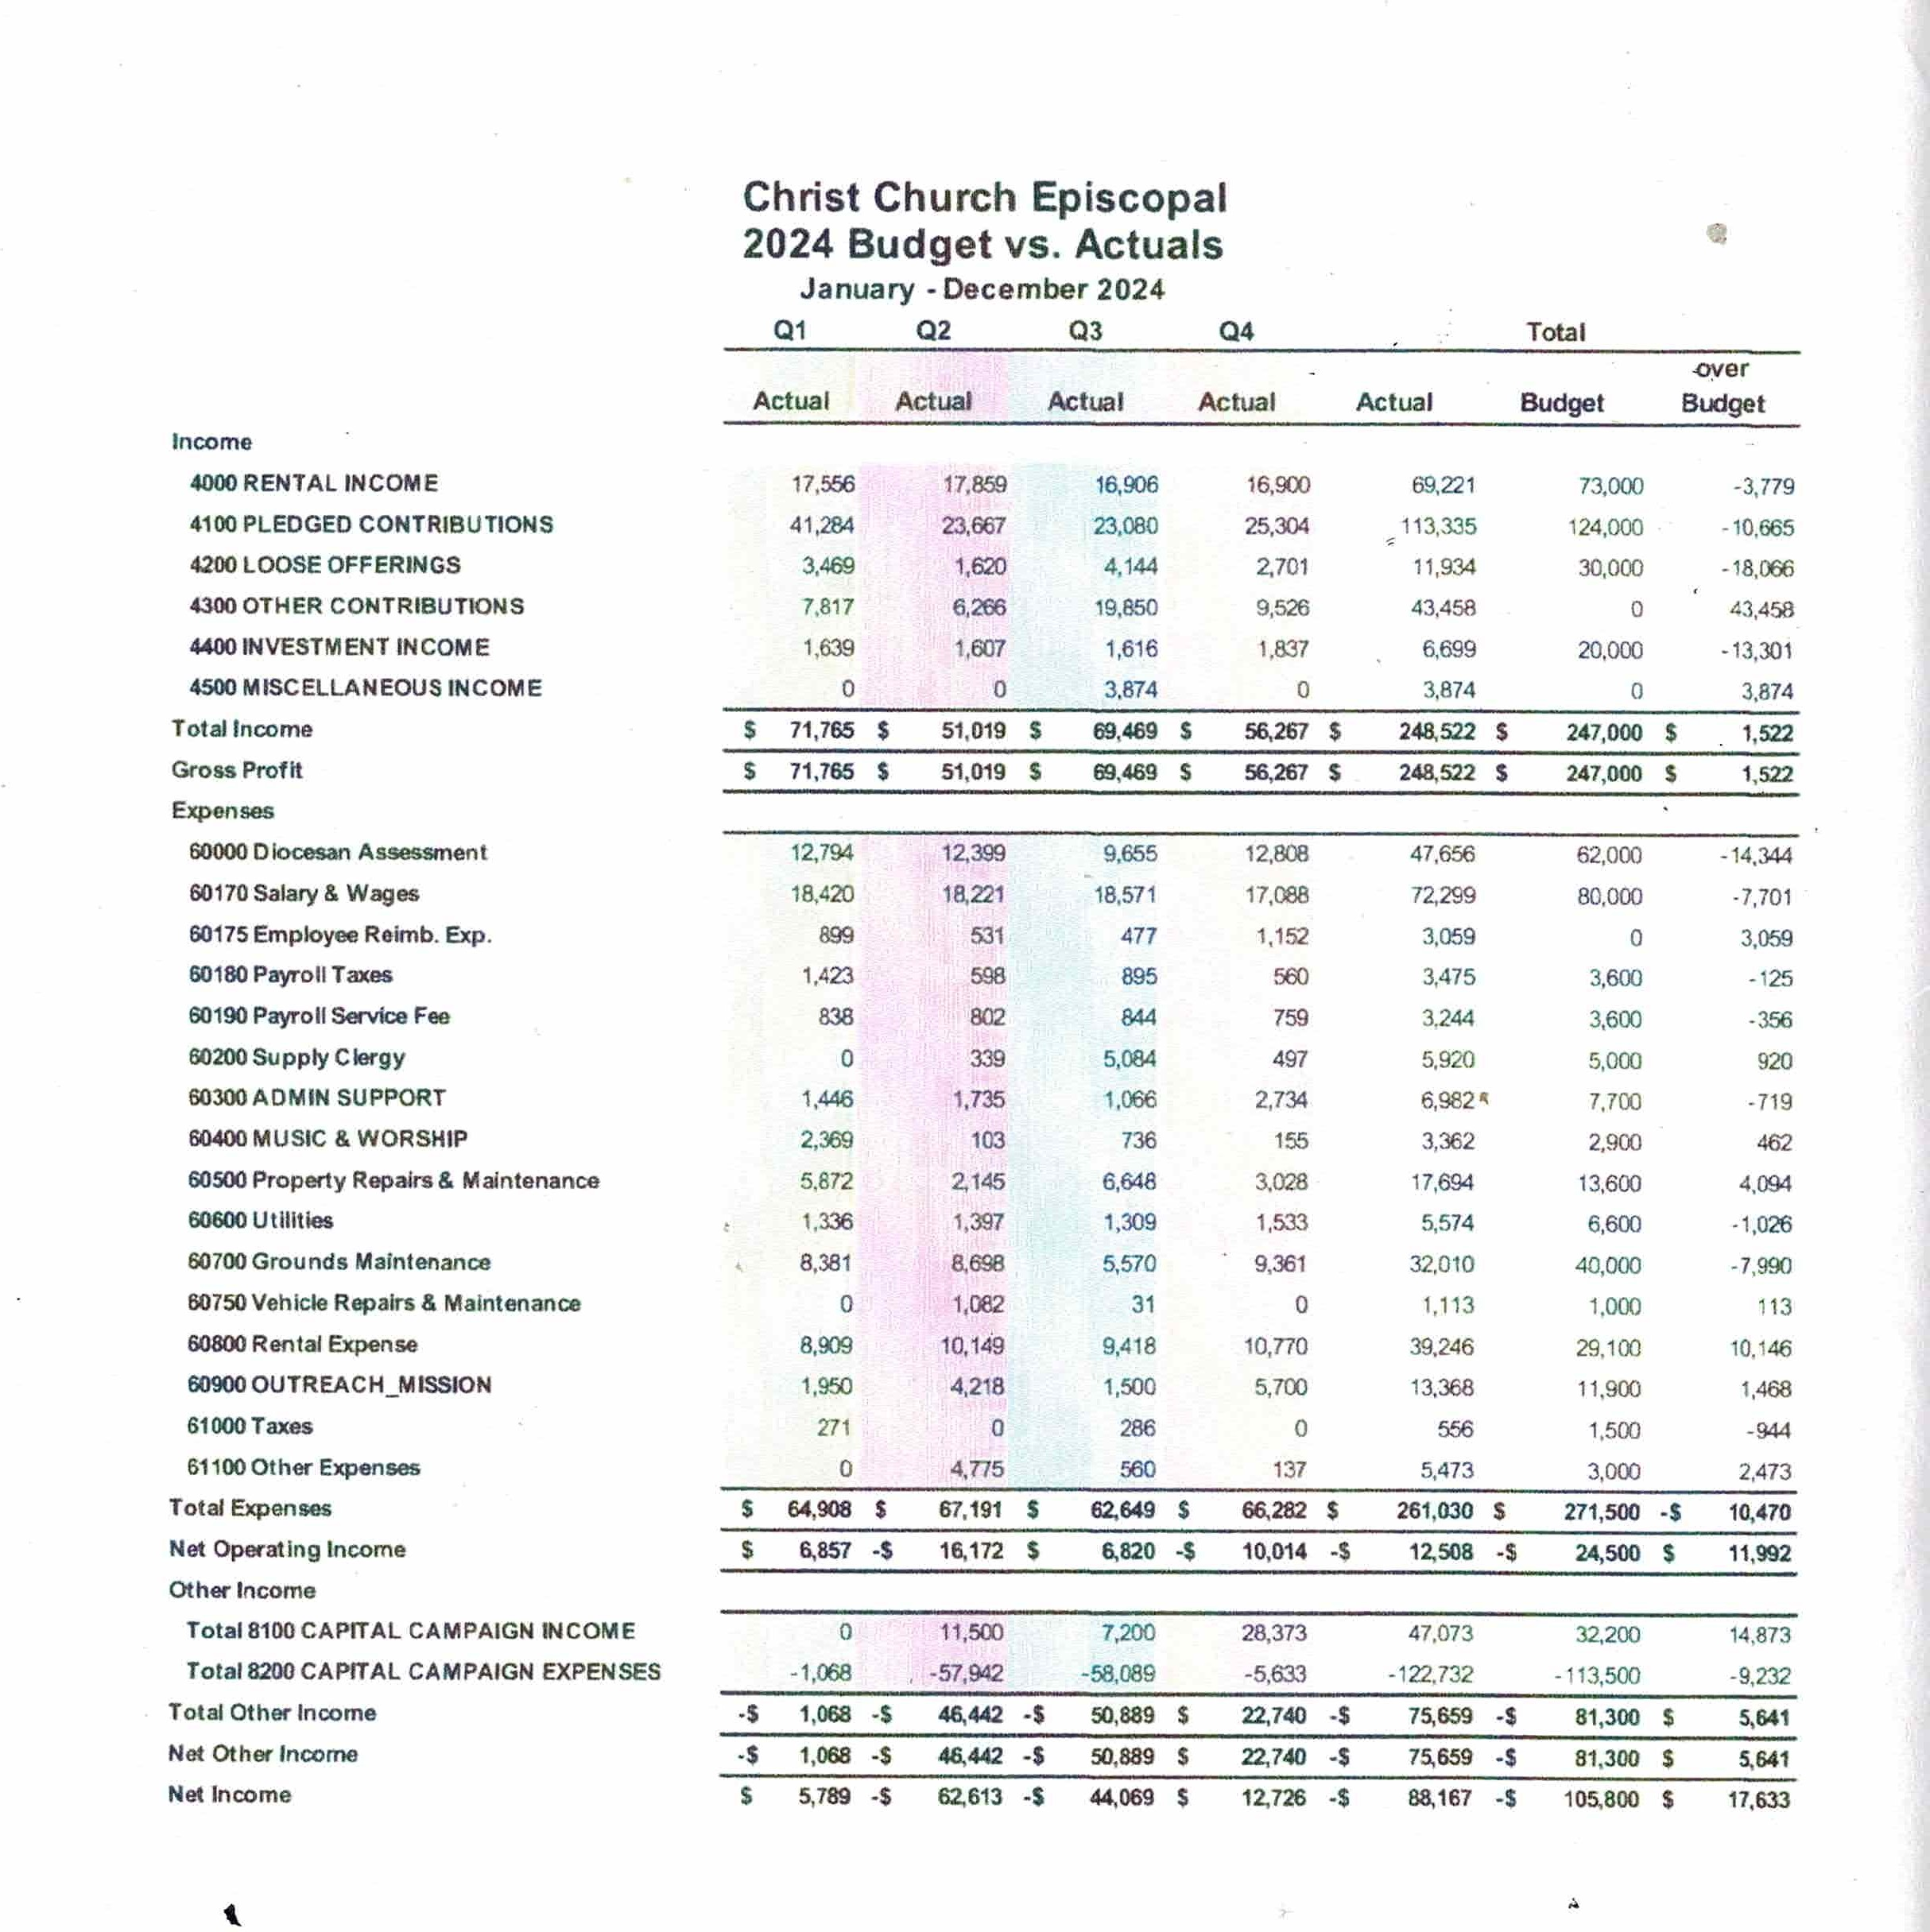

Slide 26
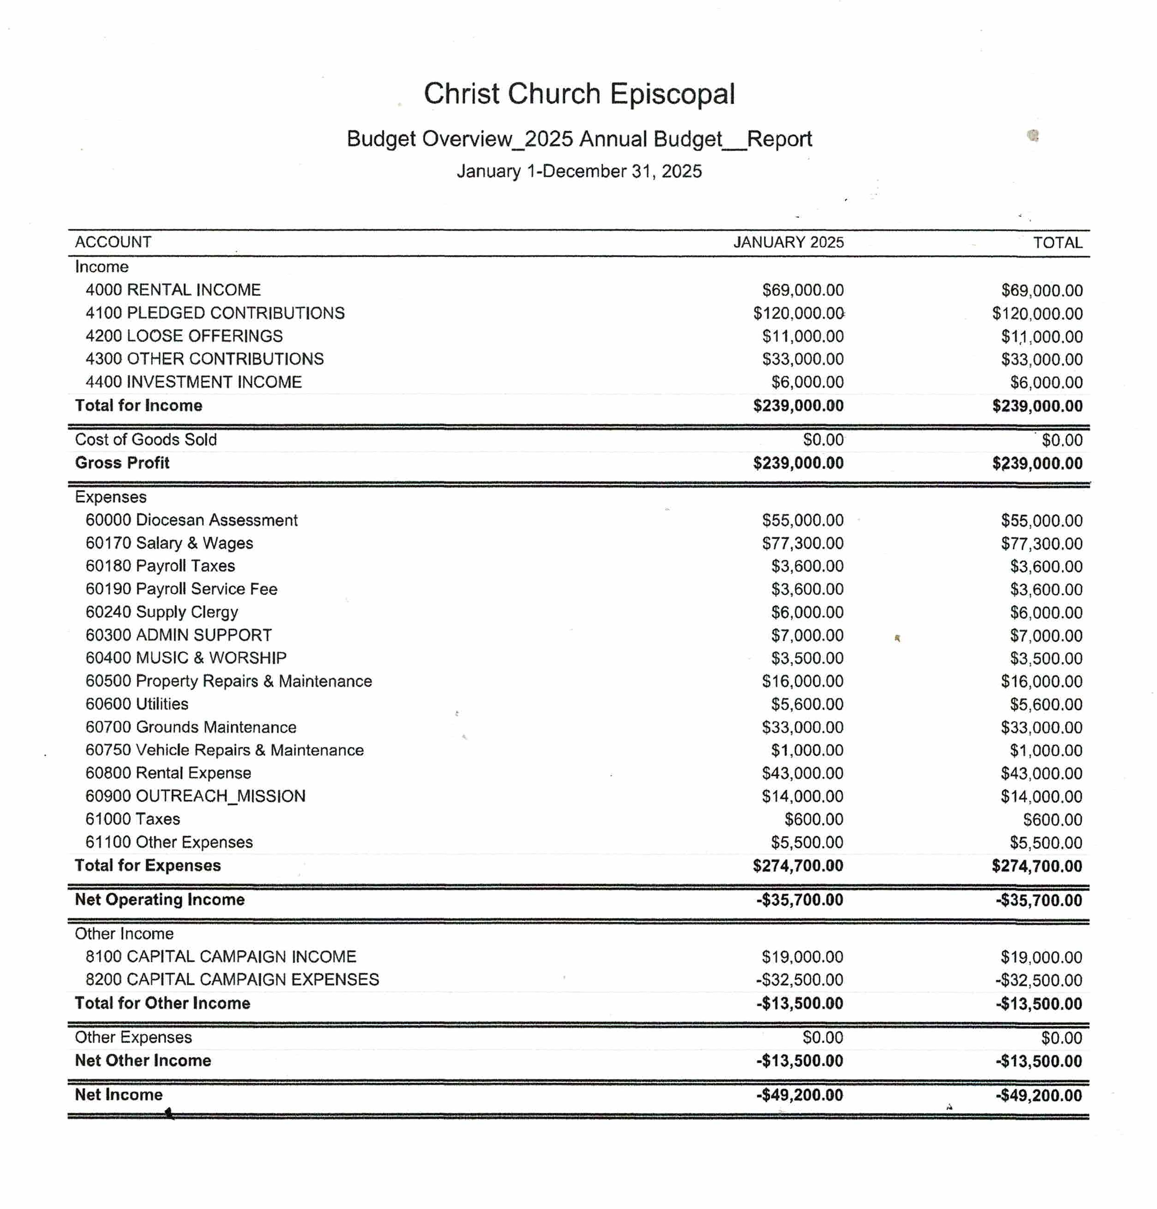

Slide 27
Altar Guild Report
Chairs: Meg Greenwell and Janet Britt
  Members: Meg Greenwell, Linda Sears and Janet and Tim Britt, Jen Valdez
  Our Committee is diligent in setting up for both services each week, as well as preparing the church for special services, including weddings, funerals, concerts, and baptisms. We also prepare the church and the altar for the various celebrations in the church calendar – Christmas, Palm Sunday, and Easter. We also clean all the brass vases, cross, candelabra, etc. so all is shiny for special days.
  The Altar Guild was ecstatic when it was decided NOT to hold services in the QECC. Moving all the items we need for communion was difficult. THANK YOU BISHOP’S COMMITTEE.
  There is one other important need for the Altar and that is for people to sign up for flowers. There is a sign-up sheet in QECC. If you bring flowers to Janet on Friday, she will put them out. MAHALO!

Slide 28
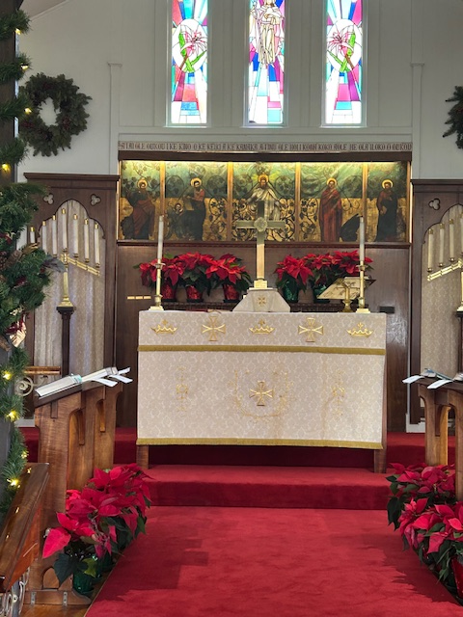
The Poinsettias on the Altar and all along the choir pews made the church extra-beautiful during the Christmas Season.
This year, a committee is working on getting the painting above the Altar repaired. It is torn in several places.

Slide 29
Cemetery Report

Slide 31
Communications Committee 2024

Slide 32
Hospitality Report

Slide 33
Nominating Report, p. 1

Slide 34


Slide 35
Nominating Report, pg 2

Slide 36
Outreach
Christ Church reaches out to its members and to the larger community in many ways.
Janet would like to allow Konawaena students to use the benches and the area in front of the church before and after school. Also, she would like to allow parents to park in the parking lot to wait for their children. This is an important community outreach.
Punana Leo
“Little Red Church” Food Security
Marshallese Community
Community Service and Volunteer Work
Queen Emma Center used by community groups, such as Vendors, Keauhou Yacht Club,
concerts

Slide 37
Pastoral Care Report

Slide 38
WORSHIP COMMITTEE

